Slide 1
Structuring System Requirements:
Process Modeling

Slide 2
Learning Objectives
Understand the logical modeling of information system processes to be presented by using Data Flow Diagrams (DFDs).
Understand how to draw DFDs consider by the rules and the guidelines of DFDs.
How to decompose DFDs and represent level and Balancing of DFDs diagrams.

Slide 3
Process Modeling
Graphically represent the processes that receive, manipulate, store and distribute data of information system and its environment.
Data flow diagrams (DFDs)
  Graphically present the movement of data between external entities and the processes and data stores within an information system.
Modeling a system’s process
  Utilize information gathered during requirements determination.
  Structure of the data is also modeled in addition to the processes.

Slide 4
Process Modeling (cont.)
Deliverables and Outcomes
  Set interrelated DFDs.
  Context data flow diagram : use to identify scope of information system.
  DFDs of current system
    Enables analysts to understand current information system.
  DFDs of new logical system
    Technology independent (Technology doesn’t matter in the DFDs).
    Show data flows, structure and functional requirements of new system.

Slide 5
Data Flow Diagramming Mechanics
Four symbols are used
  Two different standard sets can be used
Process
Data Store
Source/Sink
Entity
Data Direction

Slide 6
Data Flow Diagramming Mechanics
Data Flow
  Represent the data with the movement direction from one place to another in the system.
  Drawn as an arrow, specify a meaningful name to represent the data.
Data Store
  Represent data at rest.
  The name of the store is specified in between lines.

Slide 7
Data Flow Diagramming Mechanics
Process
  Represent action performed on data so that they are transformed, stored or distributed.
  Number of process and action are specified in symbol
Source/Sink
  Represent the origin and destination of the data.
  Usually it is the external or environment of the system.
  Name of the entity are specify within the symbol.

Slide 8
Data Flow Diagramming Definitions
Context Diagram :
  A DFD of the scope of an information system that shows the system boundaries, external entities that interact with the system and the major information flows between the entities and the system.
  Context Diagram contains no data stores.
  Next step is to expand the context diagram to show the breakdown of processes (DFDs Level 0).

Slide 9
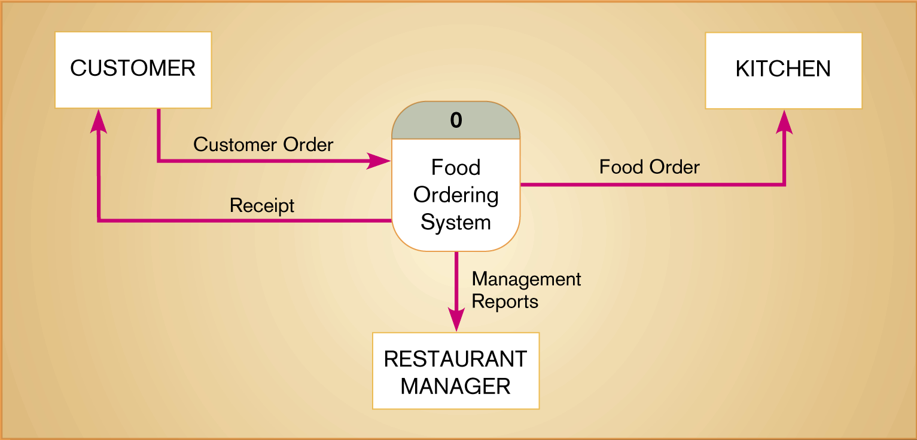
Figure 8-4 Context diagram of Hoosier Burger’s food ordering system
An Example Context Diagram
Food ordering system
** Jeffrey A. Holler, Joey F. Gorge, and Joseph S. Valacich, “Modern System Analysis & Design (4th Edition)”, Page. 203 Figure 7-4

Slide 10
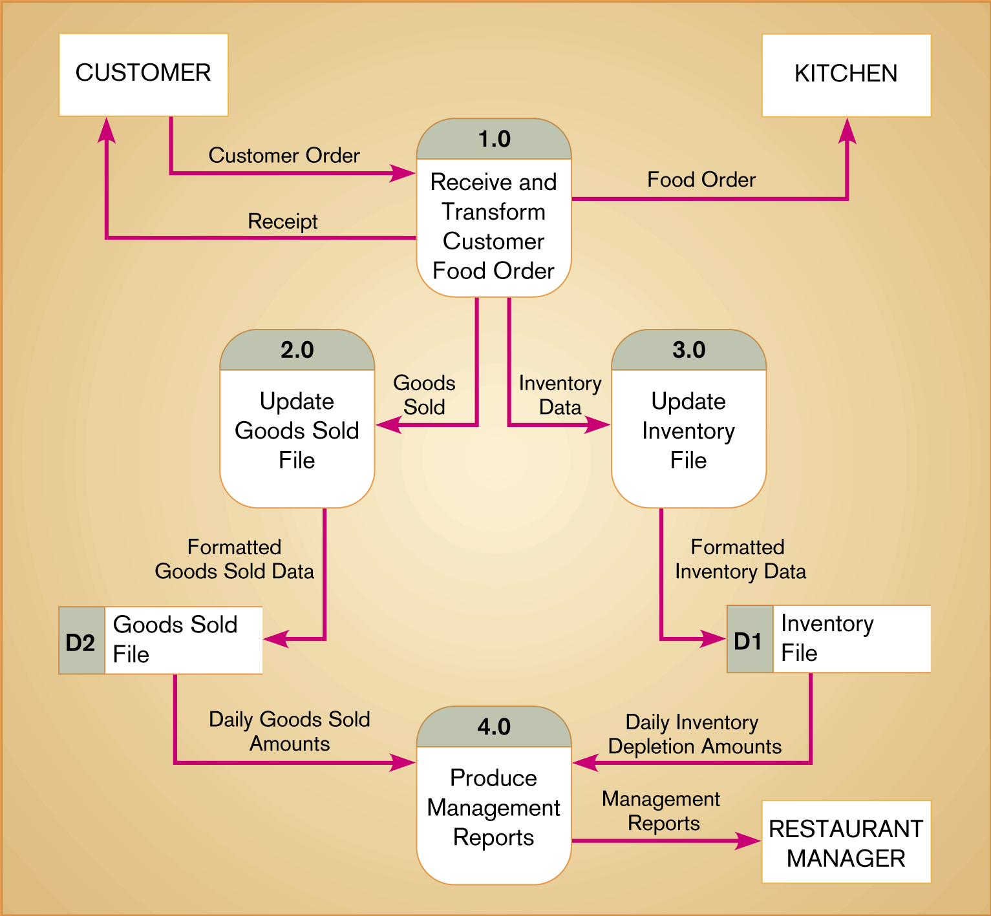
An Example Level-0 Diagram
Level-O Diagram : A DFD that represents a system’s major processes, data flows and data stores at a high level of detail
** Jeffrey A. Holler, Joey F. Gorge, and Joseph S. Valacich, “Modern System Analysis & Design (4th Edition)”, Page. 204 Figure 7-5

Slide 11
Data Flow Diagramming Rules
Basic rules that apply to DFDs:-
  Inputs to a process are always different than outputs.
  Objects always have a unique name
  In order to keep the diagram uncluttered, you can repeat data stores and sources/sinks on a diagram.

Slide 12
Data Flow Diagramming Rules
Process
No process can have only outputs (a miracle).
No process can have only inputs (black hole).
A process has a verb phrase label.
Source/Sink
Data cannot move directly from a source to a sink.
A source/sink has a noun phrase label.
Data Store
Data cannot be moved directly from one store to another.
Data cannot move directly from an outside source to a data store.
Data cannot move directly from a data store to a data sink.
Data store has a noun phrase label.

Slide 13
Data Flow Diagramming Rules
Data Flow
  A DF has a noun phrase label.
  A DF has only one direction of flow between symbols.
  A fork means that exactly the same data goes from a common location to two or more processes, data stores or sources/sinks.
  A join means that exactly the same data comes from any two or more different processes, data stores or sources/sinks to a common location.
  A DF cannot go directly back to the same process it leaves.
  A DF to a data store means update.
  A DF from a data store means retrieve or use.

Slide 14
Decomposition of DFDs
Functional decomposition
  Act of going from one single system to many component processes in details.
  Repetitive procedure.
  Lowest level is called a primitive DFD.
Level-N Diagrams
  A DFD that is the result of n nested decompositions of a series of subprocesses from a process on a level-0 diagram.

Slide 15
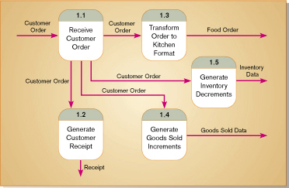
Decomposition of DFDs
Level-1 diagram showing the decomposition of Process 1.0 from the level-0 diagram for Hoosier Burger’s food ordering system
** Jeffrey A. Holler, Joey F. Gorge, and Joseph S. Valacich, “Modern System Analysis & Design (4th Edition)”, Page. 208 Figure 7-7

Slide 16
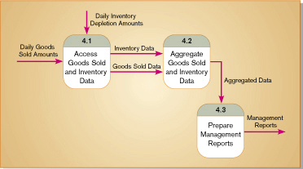

Decomposition of DFDs
Decomposition of Process 4.0 from the level-0 diagram for Food ordering system
** Jeffrey A. Holler, Joey F. Gorge, and Joseph S. Valacich, “Modern System Analysis & Design (4th Edition)”, Page. 209 Figure 7-8
Decomposition of Process 4.3 from the level-1 diagram for Food ordering system
** Jeffrey A. Holler, Joey F. Gorge, and Joseph S. Valacich, “Modern System Analysis & Design (4th Edition)”, Page. 209 Figure 7-9

Slide 17
Balancing DFDs
When decomposing a DFDs to represent in the next, you must conserve inputs to and outputs from a process.
Example: Context Diagram of Food Ordering System,
  One input to the system, the customer order
  Three outputs: Customer receipt, Food order, Management reports
On level-0 DFDs of Food Ordering System, we have the same inputs and outputs
  No new inputs or outputs have been introduced
  We can say that the context diagram and level-0 DFD are balanced

Slide 18
Balancing DFDs
0
0
An unbalanced example
  In context diagram, we have one input to the system and one output.
  Level-0 diagram has one additional entity, one additional input, and output.
  These DFDs are not balanced.
1.0
2.0

Slide 19
Balancing DFDs
Balancing leads to four additional advanced rules:-
A composite DF on one level can be split into component DFs at the next level, but no new data can be added and all data in the composite must be accounted for in one or more subflows.
The inputs to a process must be sufficient to produce the outputs from the process. Thus, all outputs can be produced, and all data in inputs move somewhere, either to another process or to a data store outside the process or on a more detailed DFD showing a decomposition of that process.
At the lowest level of DFDs, new data flows may be added to represent data that are transmitted under exceptional conditions; these DFs typically represent error messages (e.g.,”Customer not known; do you want to create a new customer”) or confirmation notices (e.g.,”Do you want to delete this record”)
To avoid having DF lines cross each other, you may repeat data stores or sources/sinks on a DFD. Use an additional symbol, like a double line on the middle vertical line of a data store symbol, or a diagonal line in a corner of a sink/source square, to indicate a repeated symbol.

Slide 20
Guidelines for Drawing DFDs
Completeness
  DFDs must include all components necessary for information system process.
Consistency
  The extent to which information contained on one level of a set of nested DFDs is also included on other levels (Balancing).

Slide 21
Guidelines for Drawing DFDs
Timing
  Time is not represented well on DFDs.
  Best to draw DFDs as if the system has never started and will never stop.
Iterative Development
  Analyst should expect to redraw diagram several times before reaching the closest approximation to the system being modeled.
Primitive DFDs
  Lowest logical level of decomposition. One process do on thing in data processing logic.

Slide 22
Guidelines for Drawing DFDs
Rules for stopping decomposition
  When each process has been reduced to a single action in data processing logic, calculation or database operation.
  When each data store represents data about a single entity.
  When the system user does not care to see any more detail.
  When every DF does not need to be split further.

Slide 23
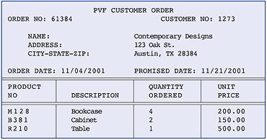
Example of Customer Order for Bottom-Up Analysis
** Jeffrey A. Holler, Joey F. Gorge, and Joseph S. Valacich, “Modern System Analysis & Design (4th Edition)”, Page. 273 Figure 9-4
Figure 9-4 Simple Customer Order

Slide 24
Entity-Relationship (E-R) Modeling
Three main constructs in E-R Diagrams:-
  Data entities
  Relationships
  Attributes
Entity-Relationship (E-R) Diagram
  A detailed, logical representation of the entities, associations and data elements for an organization or business.

Slide 25
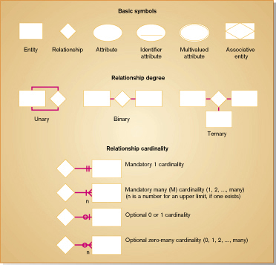
** Jeffrey A. Holler, Joey F. Gorge, and Joseph S. Valacich, “Modern System Analysis & Design (4th Edition)”, Page. 274 Figure 9-5

Slide 26
Entity-Relationship (E-R) Modeling
Key Terms
Entity
  A person, place, object, event or concept in the user environment about which the organization wishes to maintain data.
  Represented by a rectangle in E-R diagrams.
Entity Type
  A collection of entities that share common properties or characteristics.
Attribute
  A named property or characteristic of an entity that is of interest to an organization.

Slide 27
Entity-Relationship (E-R) Modeling
Key Terms … cont.
Candidate keys and identifiers
  Each entity type must have an attribute or set of attributes that distinguishes one instance from other instances of the same type.
  Candidate key : Attribute (or combination of attributes) that uniquely identifies each instance of an entity type.

Slide 28
Entity-Relationship (E-R) Modeling
Key Terms … cont.
Identifier
  A candidate key that has been selected as the unique identifying characteristic for an entity type.
  Selection rules for an identifier:-
    Choose a candidate key that will not change its value.
    Choose a candidate key that will never be null.
    Avoid using intelligent keys.
    Consider substituting single value surrogate keys for large composite keys.

Slide 29
Entity-Relationship (E-R) Modeling
Key Terms … cont.
Multivalued Attribute
  An attribute that may take on more than one value for each entity instance
  Represented on E-R Diagram in two ways:
    double-lined ellipse
    weak entity : to separate the repeating data into another entity

Slide 30
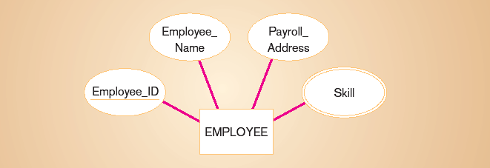
Entity and Attribute Example
Identifier attribute… each employee has a unique ID.
Multivalued attribute… an employee may have more than one skill.
** Jeffrey A. Holler, Joey F. Gorge, and Joseph S. Valacich, “Modern System Analysis & Design (4th Edition)”, Page. 278

Slide 31
Entity-Relationship (E-R) Modeling
Key Terms … cont.
Relationship
  An association between the instances of one or more entity types that is of interest to the organization.
  Association indicates that an event has occurred or that there is a natural link between entity types.
  Relationships are always labeled with verb phrases.

Slide 32
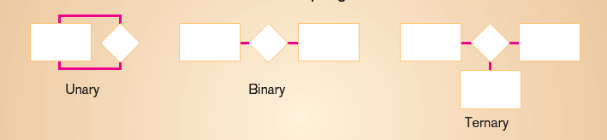
Degree of Relationship
Degree: number of entity types that participate in a relationship.
Three cases:-
  Unary: between two instances of one entity type.
  Binary: between the instances of two entity types.
  Ternary: among the instances of three entity types.
** Jeffrey A. Holler, Joey F. Gorge, and Joseph S. Valacich, “Modern System Analysis & Design (4th Edition)”, Page. 274 Figure 9-5

Slide 33
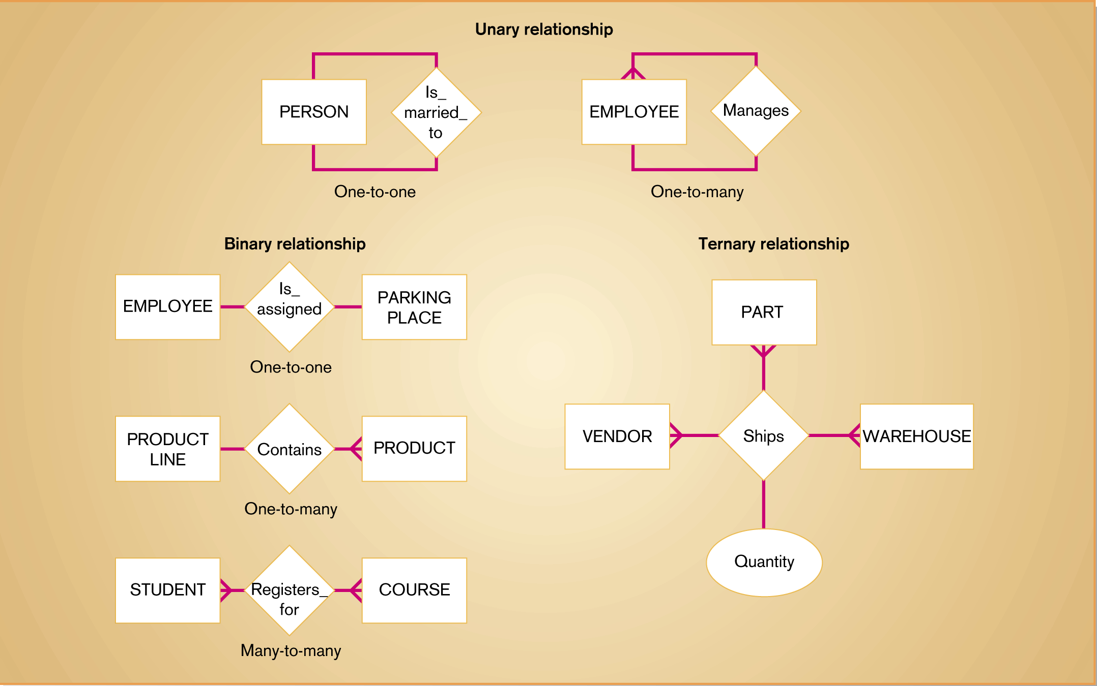
Example relationships of different degrees
** Jeffrey A. Holler, Joey F. Gorge, and Joseph S. Valacich, “Modern System Analysis & Design (4th Edition)”, Page. 281 Figure 9-6

Slide 34
Cardinality
Identify the number (minimum and maximum) of instance between related Entities.
Minimum Cardinality
  The minimum number of instances between related Entities.
Maximum Cardinality
  The maximum number of instances between related Entities.
Mandatory vs. Optional Cardinalities
  Specifies whether an instance must exist or can be absent in the relationship.

Slide 35
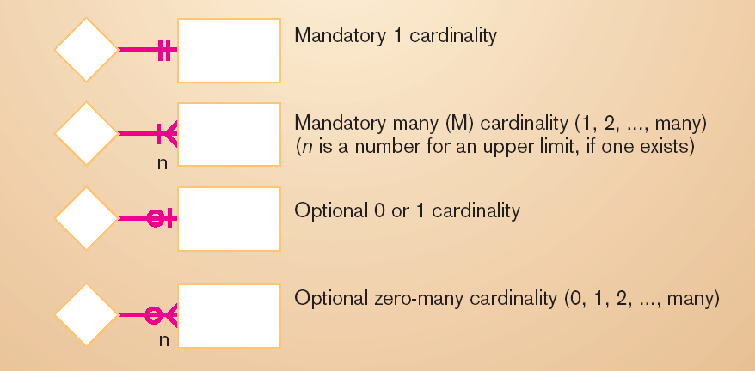
Cardinality Symbols
** Jeffrey A. Holler, Joey F. Gorge, and Joseph S. Valacich, “Modern System Analysis & Design (4th Edition)”, Page. 274 Figure 9-5

Slide 36
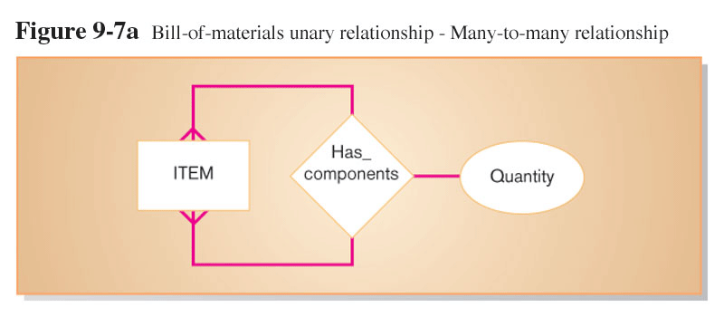
Unary Relationship Example
** Jeffrey A. Holler, Joey F. Gorge, and Joseph S. Valacich, “Modern System Analysis & Design (4th Edition)”, Page. 282 Figure 9-7a

Slide 37
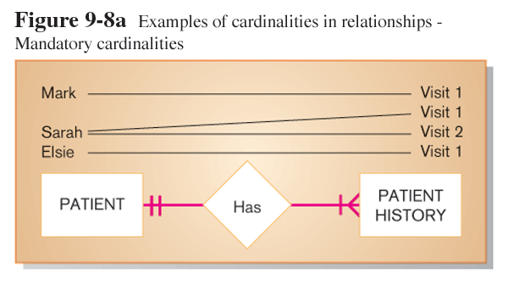
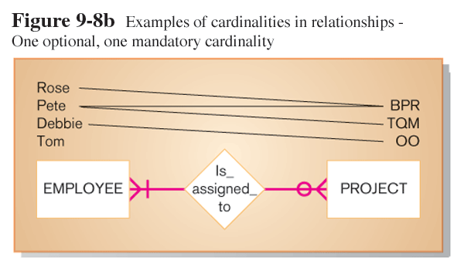
Binary Relationship Examples
** Jeffrey A. Holler, Joey F. Gorge, and Joseph S. Valacich, “Modern System Analysis & Design (4th Edition)”, Page. 284 Figure 9-8a and 9.8b

Slide 38
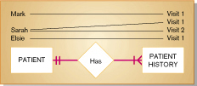
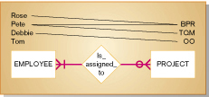
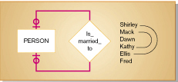
** Jeffrey A. Holler, Joey F. Gorge, and Joseph S. Valacich, “Modern System Analysis & Design (4th Edition)”, Page. 284 Figure 9-8a, 9.8b, and 9-8c
Mandatory Cardinalities
One Option, one mandatory Cardinalities
Optional Cardinalities

Slide 39
Associative Entities
In Many to Many Relationship, the Associative Entity is represent to contain attributes that are peculiar to the relationship between those entity instances.
An associative entity is:-
  An entity
  A relationship

Slide 40

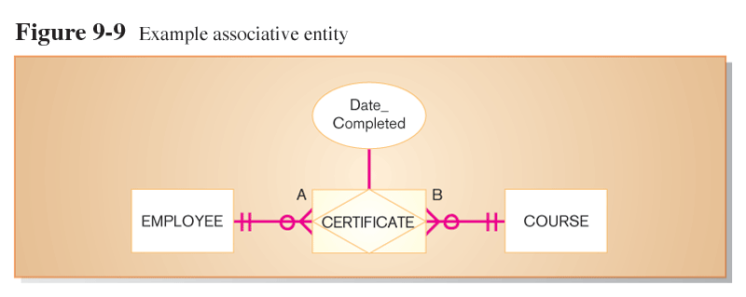
Example of Associative Entity from
M-to-M relationship
** Jeffrey A. Holler, Joey F. Gorge, and Joseph S. Valacich, “Modern System Analysis & Design (4th Edition)”, Page. 286 Figure 9-9

Slide 41
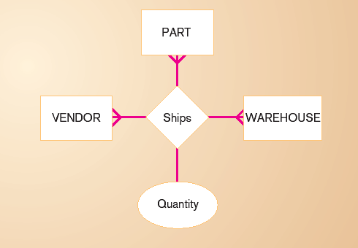
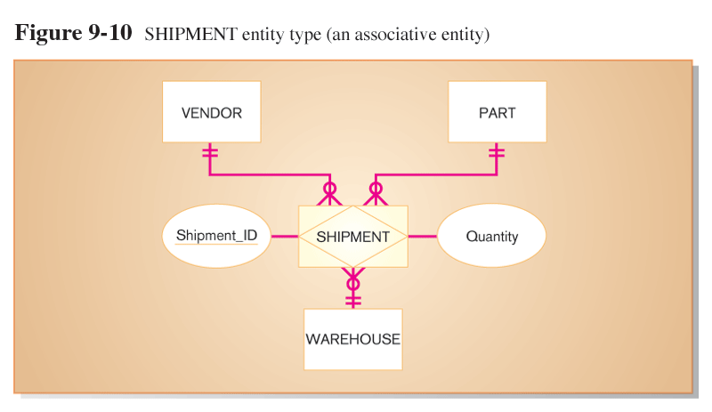
Example of Associative Entity from
Ternary relationship
** Jeffrey A. Holler, Joey F. Gorge, and Joseph S. Valacich, “Modern System Analysis & Design (4th Edition)”, Page. 286 Figure 9-10

Slide 42
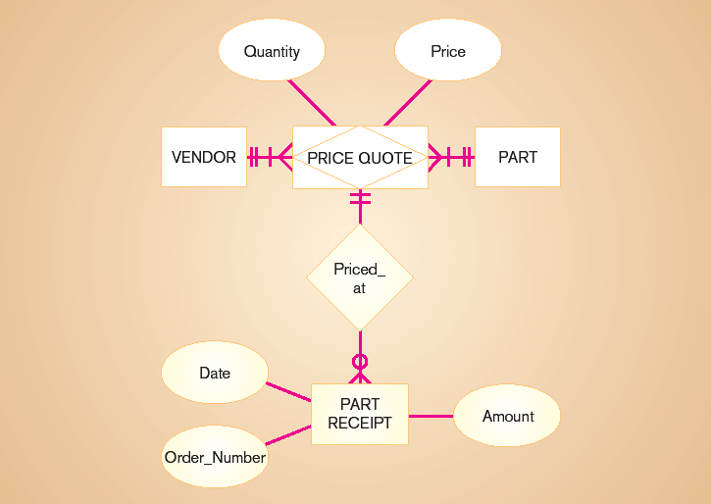
Example of a relationship that general entity has relationship with an associative entity.
** Jeffrey A. Holler, Joey F. Gorge, and Joseph S. Valacich, “Modern System Analysis & Design (4th Edition)”, Page. 287

Slide 43
Integrity Rules
Specifications that preserve the integrity of the logical data model include:-
  Entity integrity: unique, non-null identifiers.
  Referential integrity constraints: rules governing relationships.
  Domains: The set of all data types and ranges of values that an attribute can assume. The objective of domain are:-
    Verify that the values for an attribute are valid.
    Ensure that various data manipulation operations are logical.
    Help conserve effort in describing attribute characteristics.

